Slide 1
Autonomous Mobile Robots
Control and Planning: Autonomous Mobile Robots and Autonomous Vehicles
Aliasghar Moj Arab

Slide 2
Lecture 1
P A R T 0 1
Introduction to Mobile Robots

Slide 3
Topics
Introduction & Physical Constraints
Vehicle Kinematics & Equations of Motion
Control & Perception Fundamentals
Nonlinear Control Methods
Advanced Model Predictive Control (NMPC) + Constraints
Motion Planning Algorithms (RRT*, RRT, DWA, path generation)
Learning-Based Planning & Control
Industry Standards, Architectures, & Safety

Slide 4
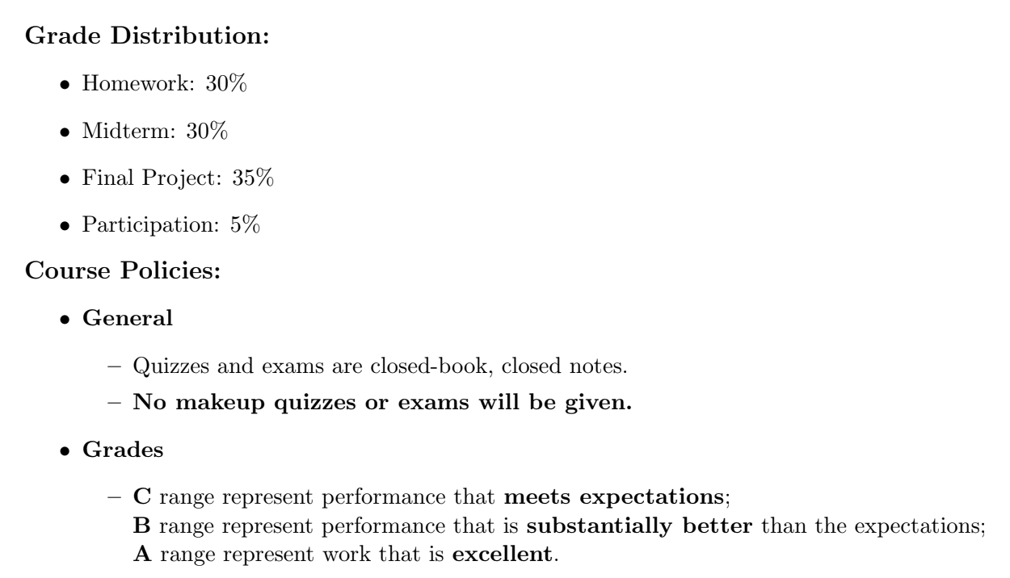
P A R T 0 1

Slide 5
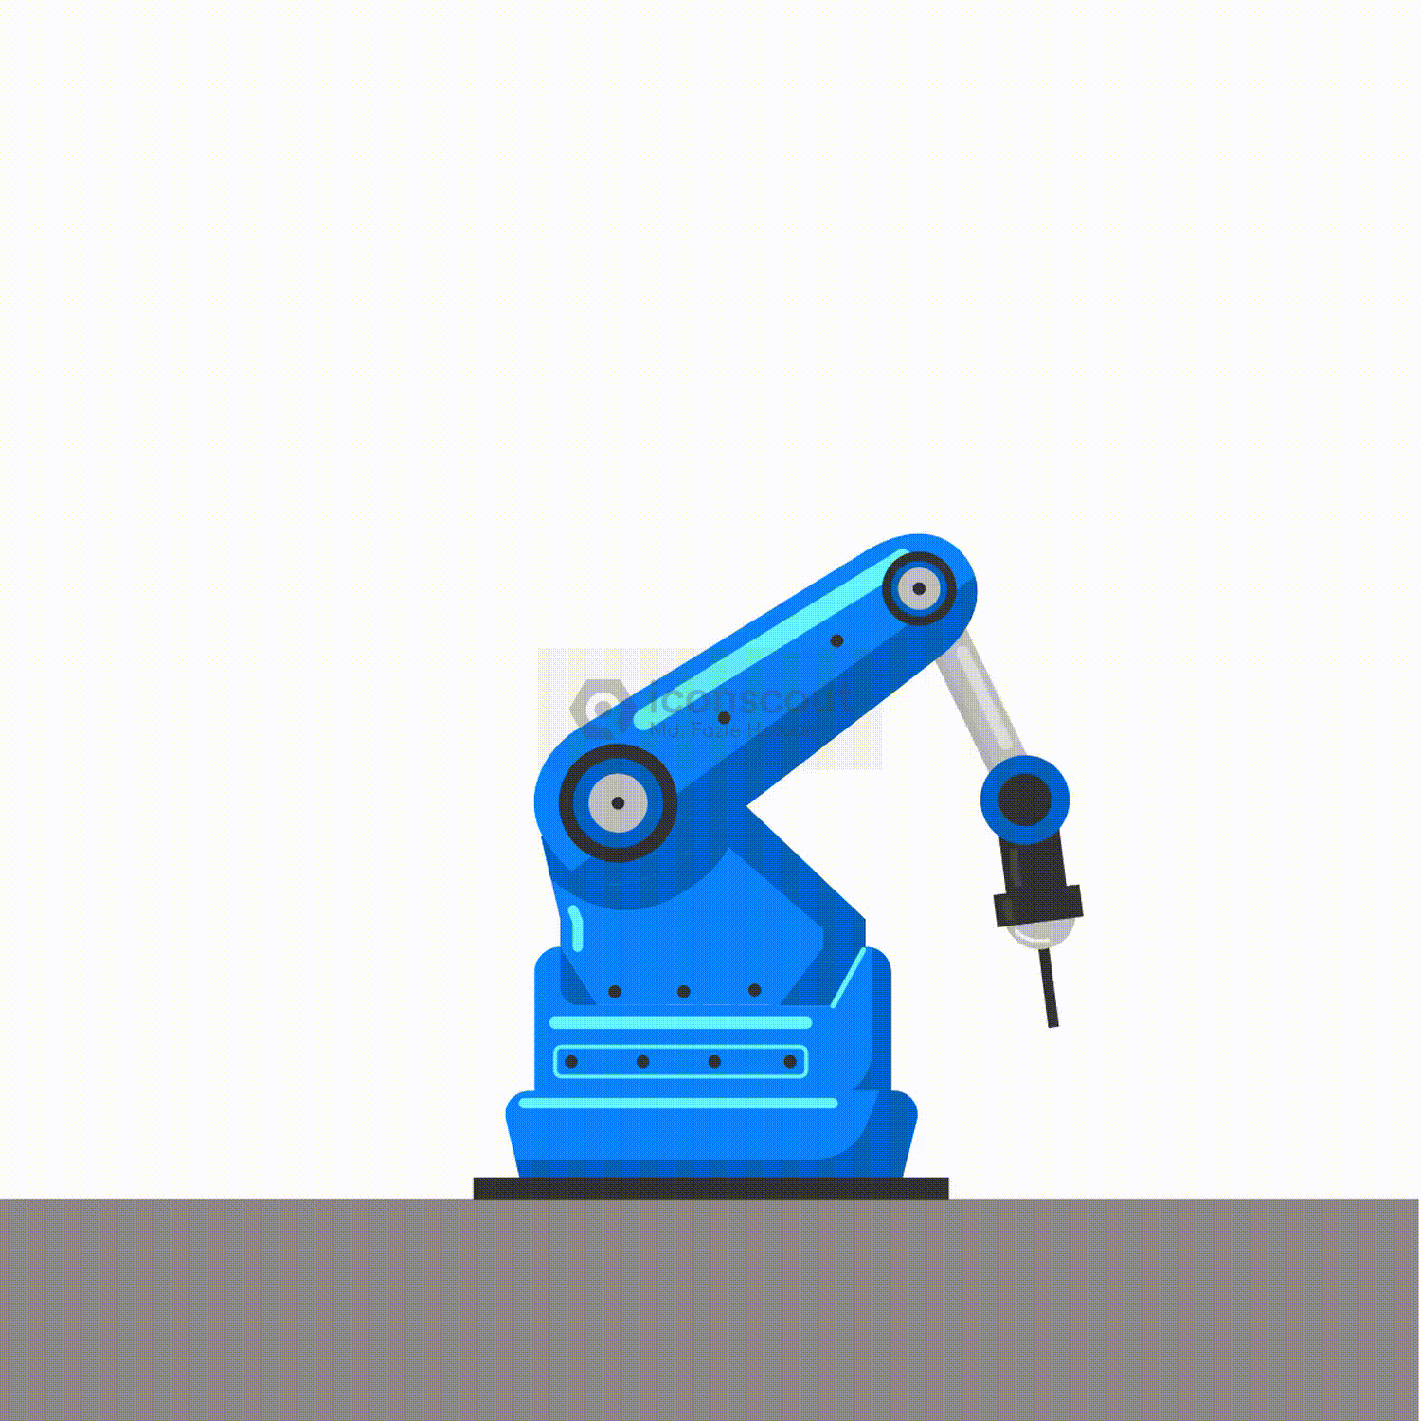
Introduction to AMR
Fixed-base robots: powerful but immobile (bolted to floor)
Industry Workhorses: With their incredible speed and accuracy, stationary robot arms transformed manufacturing.
By design, they are confined to a fixed workspace because they are bolted to the floor.
Limitation → Mobility Challenge
Industrial Robot by Md. Fazle Hossain on IconScout

Slide 6
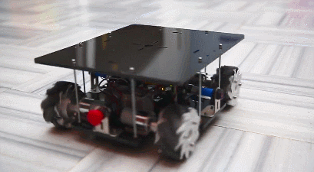
Introduction to AMR
Lack of mobility = limited flexibility: without the ability to move, these robots can't adapt to changing tasks and environments.
Although the majority of mobile robots are bioinspired and capable of walking, jumping, sliding, and swimming.
What is it about a particular locomotion that makes it superior to other forms of locomotion?
https://www.gadgetify.com/wp-content/uploads/2017/04/03/nalma.gif

Slide 7
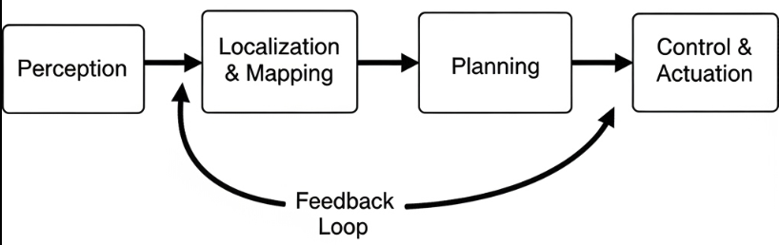
How do AMRs think?
Perception: The robot senses its environment using cameras, LiDAR, IMUs, and other sensors.
Localization & Mapping: From perception, it estimates where it is and builds a map of the world.
Planning: Based on goals or mission commands, it decides where to go next and selects a path.
Control & Actuation: Converts planned motion into motor commands on how to get there.
Feedback Loop: Continuous cycle of sensing, deciding, and acting under uncertainty.

Slide 8
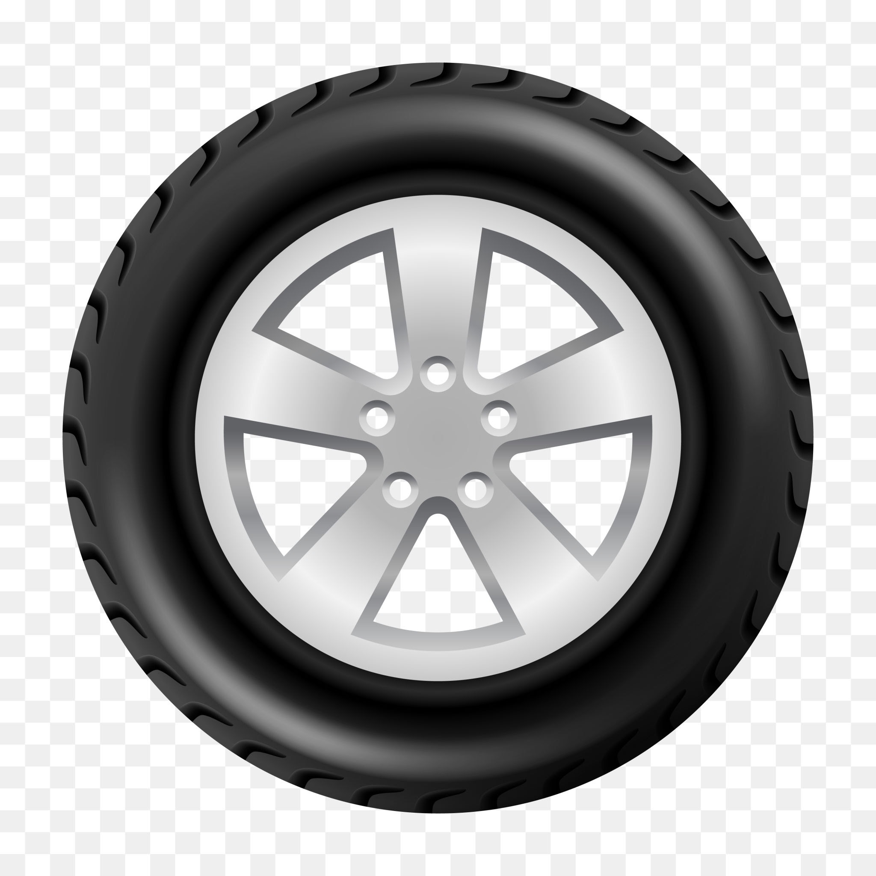
From Fixed Bases to Mobile Robots
The main question is, how should the robot move?
Wheels, legs, tracks, and hybrids are available options.
Every mechanism has unique advantages and disadvantages.
Wheels are the most effective means of mobility.

Slide 9
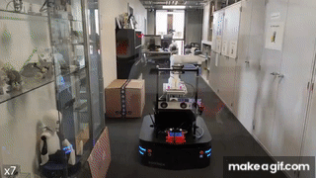
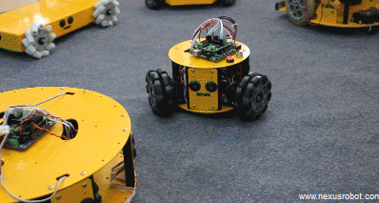
Locomotion: The First Challenge
What is locomotion first?
The ability of a robot to move through its environment by applying forces to the ground. Mobility determines an AMR's range and performance.

Slide 10
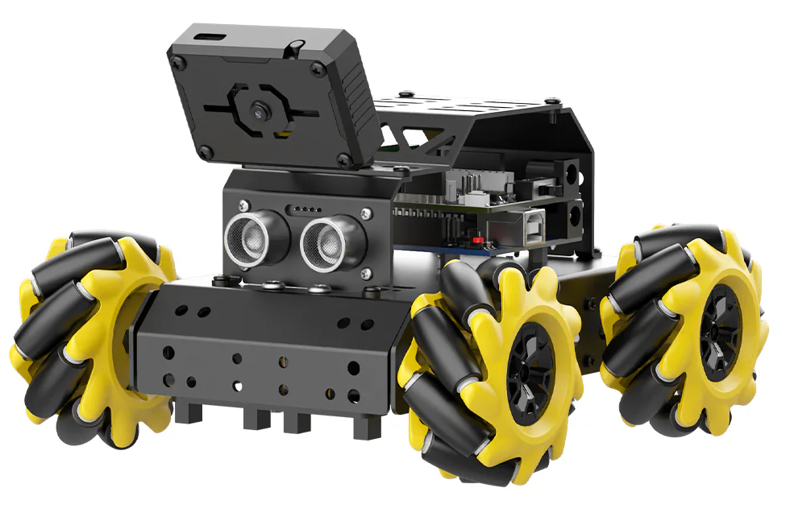
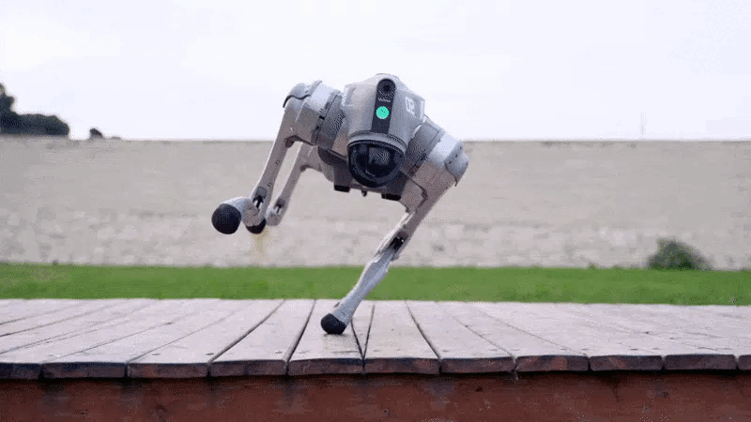
Locomotion: The First Challenge
Two basic locomotion strategies are: Wheels Legs
https://www.hiwonder.com/cdn/shop/files/b8421501ceee8ed8defa49d79fc692df_f5babd3f-bfc4-4c93-b31e-6b2f74ffac35.jpg?v=1723258982
https://spectrum.ieee.org/media-library/gif-animation-of-a-quadruped-robot-performing-acrobatic-maneuvers-on-a-wooden-platform-that-sits-on-a-grass-filled-yard.gif?id=34660828&width=1200&height=675

Slide 11
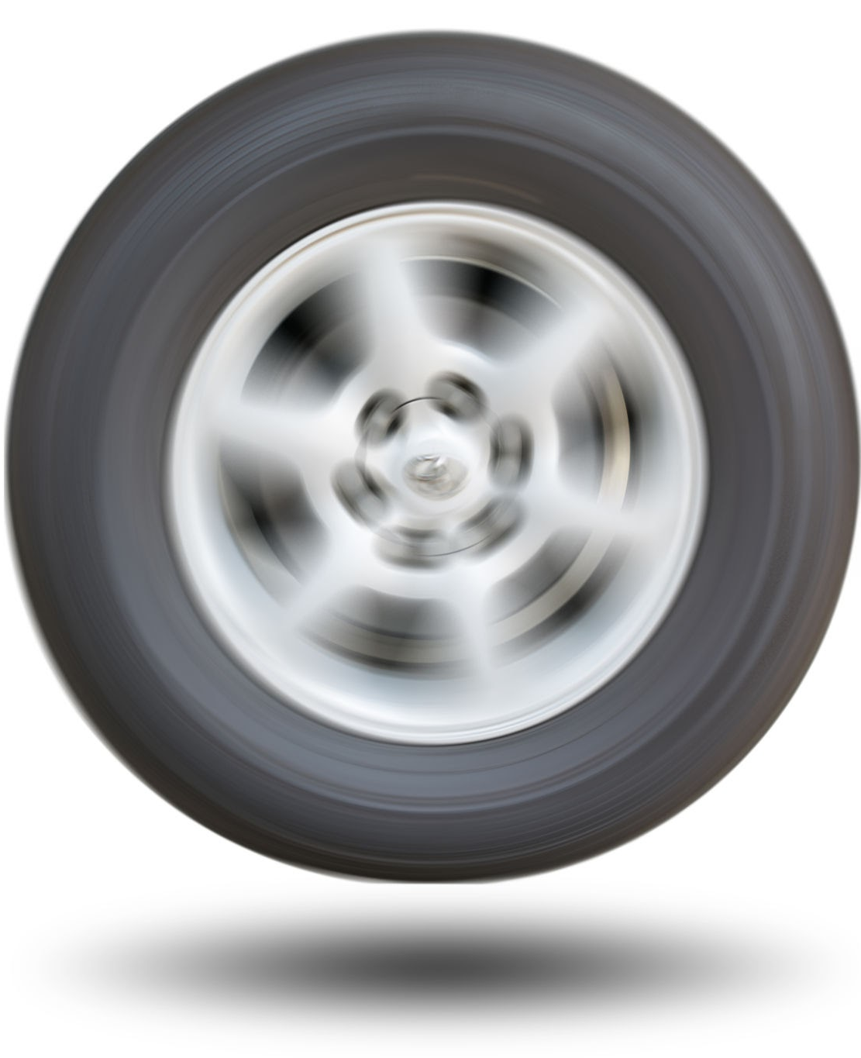
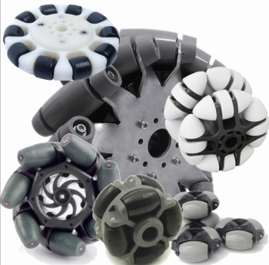
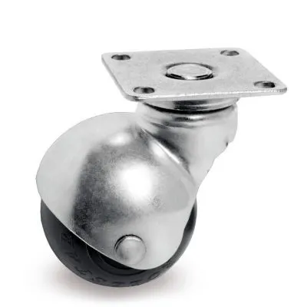
Wheels
Tolerance to Frictions on 2 directions
Tolerance to Frictions on 1 direction
Omni
Mecanum
Tolerance to Frictions on 0 direction

Slide 12
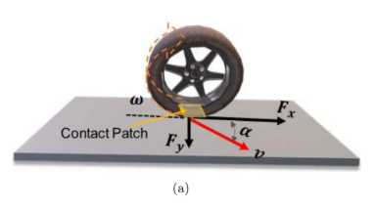
Standard wheel
Two degrees of freedom.
Rotation around the (motorized) wheel axle and the contact point.
Rolls only in its main direction, resisting side slip.
Can be used as a drive or Idler wheel

Slide 13
Omni wheel
One degrees of freedom.
Rotation around the (motorized) wheel axle and the contact point.
Rolls on its main direction with no or some side slip resistance

Slide 14
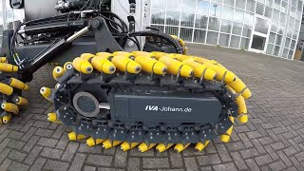
Types of wheels
Mecanum wheel
Three degrees of freedom.
Rollers mounted around rim (90° or 45°).
Allows rolling in the main direction and sideways slip with low resistance.
Commonly used for holonomic robots when multiple wheels are combined.
https://www.youtube.com/watch?v=1E2AlYuAVkU

Slide 15
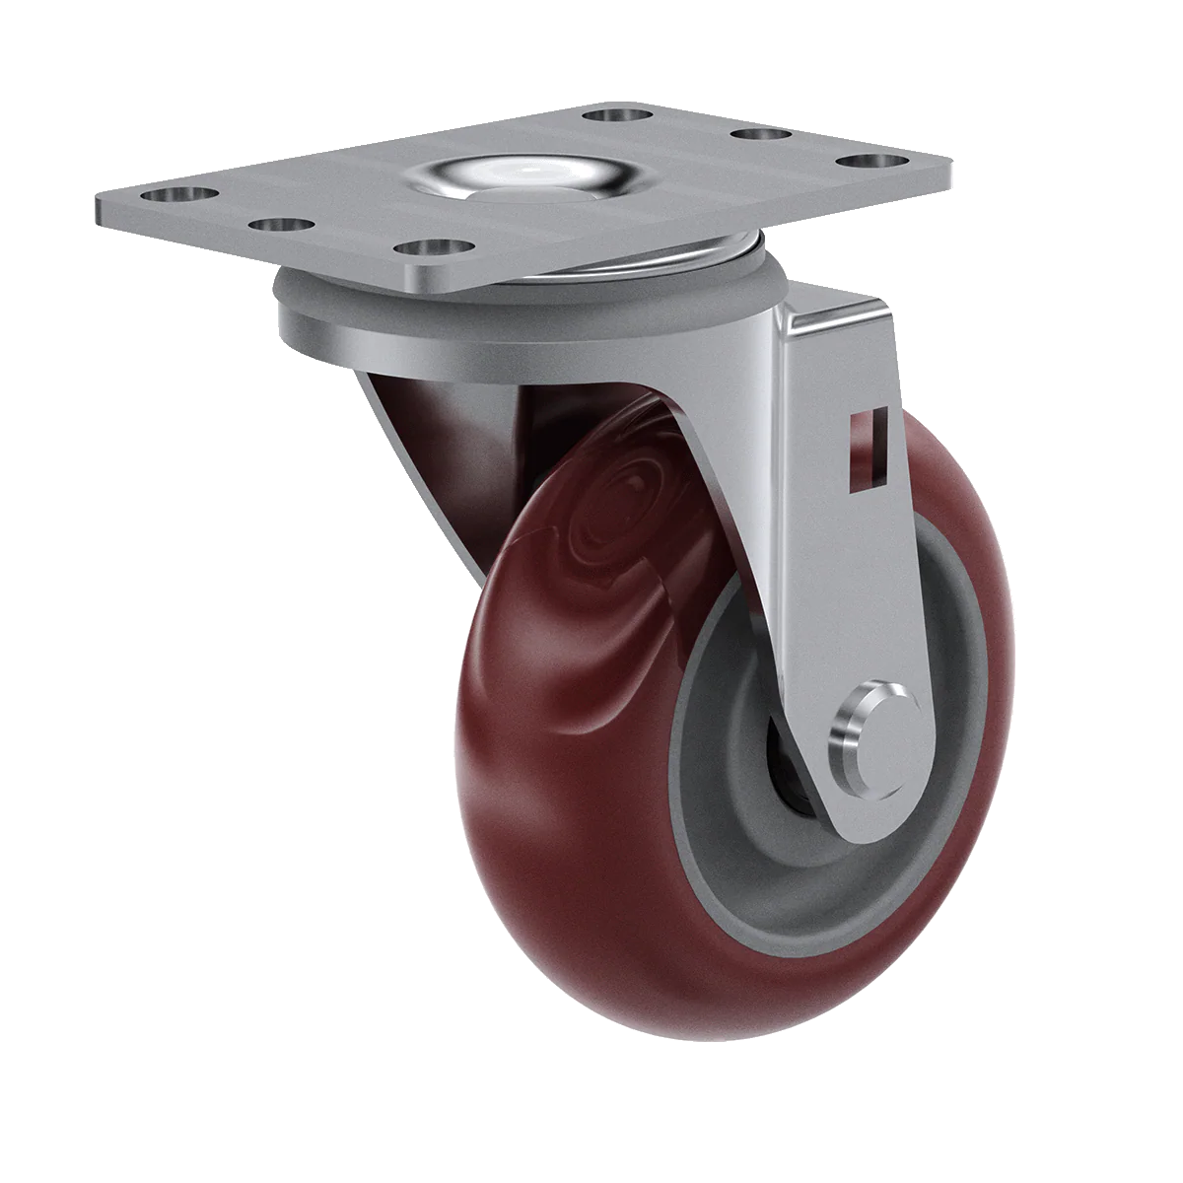
Caster Wheel
Two degrees of freedom.
Rotation around an offset steering joint.
passive, swivels freely → reduces drag during turns.
The standard wheel and the caster wheel have a primary axis of rotation and are thus highly directional.

Slide 16
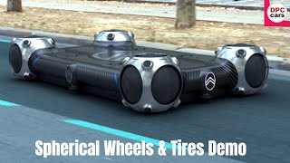
Types of wheels
Ball or spherical wheel
Three degrees of freedom.
Can rotate in any direction.
Usually passive (support wheel) rather than active drive.
Advantage: free movement support.
Disadvantage: limited load capacity, higher friction.
https://www.youtube.com/watch?v=Tr83-rCwG4k

Slide 17
Active vs Passive Wheels
Active Wheels: Motor-driven; provide propulsion and steering forces. Example: Drive wheels in differential-drive robots.
Passive Wheels: Unpowered; provide support and stability. Example: caster or idler wheels.
Next → how wheels interact with the ground (friction, forces).

Slide 18
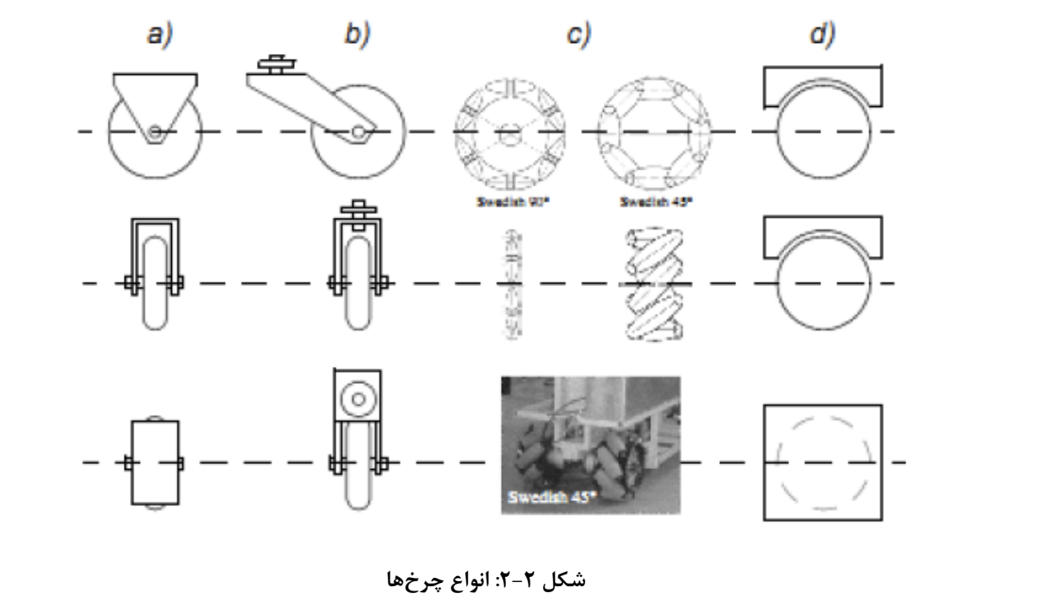

Slide 19
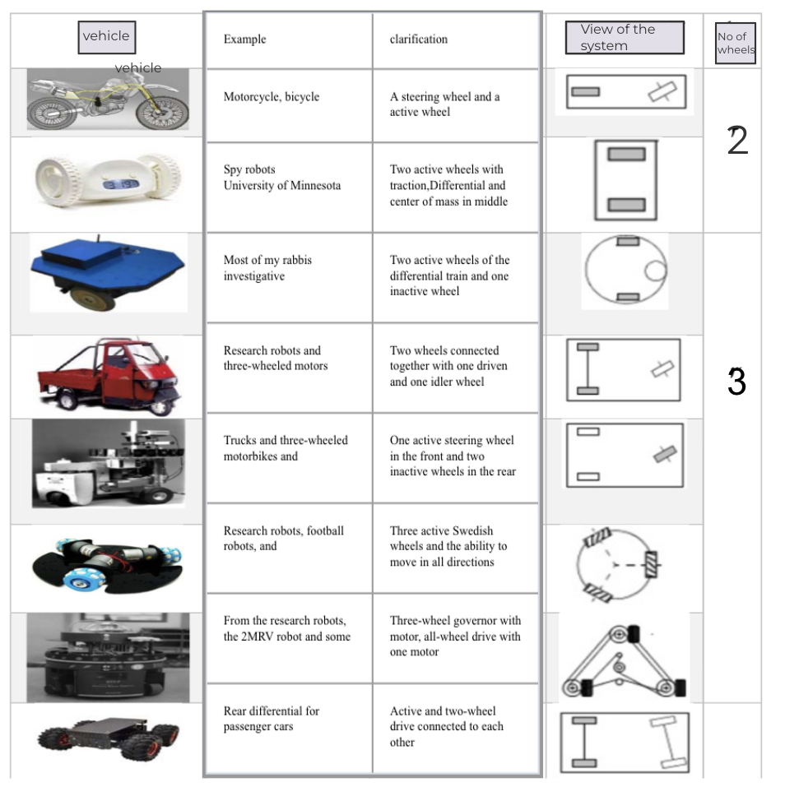
View of the system
No of wheels
2
3

Slide 20
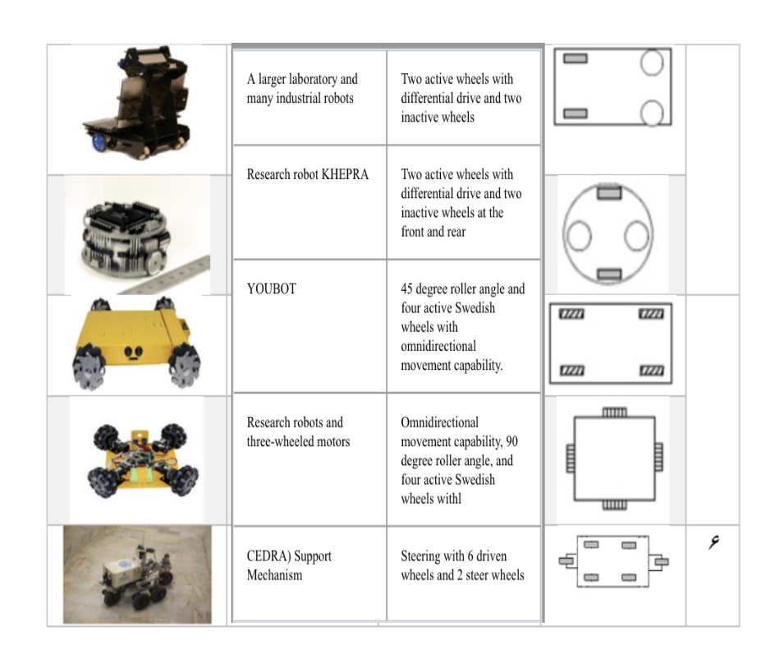
4
6

Slide 21
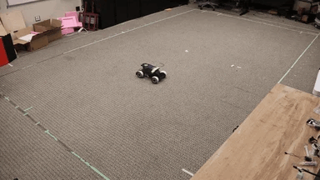
Wheel-Ground Interaction
Wheel balance is not a topic of much research; instead, the focus is on wheel traction, stability, maneuverability, and control.
Locomotion is only possible by exchanging the forces with the ground at the wheel contact patch.
https://images.spr.so/cdn-cgi/imagedelivery/j42No7y-dcokJuNgXeA0ig/dc74dd37-2821-4732-bce3-1deb894a0f0c/drift_policy-ezgif.com-cut/w=384,quality=90,fit=scale-down

Slide 22
Wheel-Ground Interaction
Constraint (Friction Circle): Fx² + Fy² ≤ (μ·Fz) ²
Forces at the contact patch:
𝐹ₓ (Longitudinal Force): Responsible for driving or braking.
𝐹ᵧ (Lateral Force): Acts during turning or side slip.
𝐹𝓏 (Normal Force): The vertical load pressing the wheel to the ground.
μ: Coefficient of friction between tire and road.
(a) The schematic view of a tire.

Slide 23
Interpretation & Implication
Interpretation: The combined forward and sideways force cannot exceed friction; if it does, then the wheel slips. Implication: Robots cannot accelerate/brake and turn at maximum levels simultaneously. Wheel-ground interaction sets the true limits of robot mobility.

Slide 24
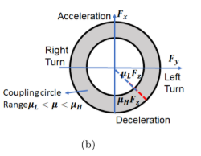
The Friction Circle and Vehicle Stability
The limited tire forces produced at the tire-road contact patch determine the stability of the vehicle.
The friction circle surrounds these forces: √(Fx² + Fy²) ≤ μ|Fz|

Slide 25
The Friction Circle and Vehicle Stability
Why does this matter? Instability results from sliding or slipping when driving normally.
Skilled drivers employ controlled slip (trail-braking, pendulum turns) in aggressive maneuvers to increase agility and prevent collisions.

Slide 26
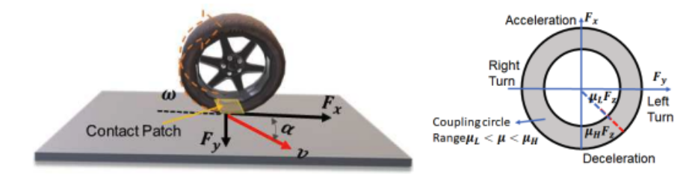
The main obstacle (control challenge)
The main obstacle:
The interaction between tires and roads is very unpredictable and nonlinear.
Due to the inefficiency of traditional controllers, sophisticated planning and control strategies are needed.

Slide 27
In case of Aggressive Maneuvers
Aggressive maneuvers: research uses driver behaviors (trail-braking, pendulum turns) to understand safe/attractive regions under control.
Stability at the limit depends on four small contact patches; μ is uncertain in real time.
The friction circle captures the bound on usable tire force: √(Fx² + Fy²) ≤ μ|Fz|.
For emergency avoidance, controlled sliding can improve agility when planned within these limits.

Slide 28
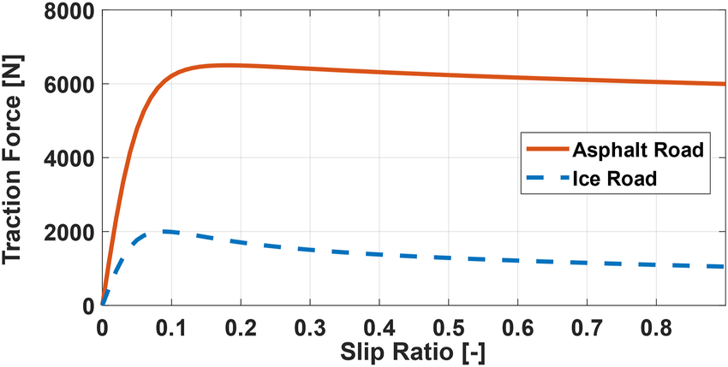
Slip and Traction
Slip Ratio (λ):
λ = (Rω − v) / max(Rω, v)
Rω: wheel’s linear speed if rolling without slip.
v: actual forward velocity of the robot.
λ = 0 → pure rolling (no slip).
λ > 0 → driving slip (wheel spins).
λ < 0 → braking slip (wheel skids).
https://www.researchgate.net/publication/360410854/figure/fig3/AS:11431281179270650@1691168705203/The-relationship-between-the-traction-force-and-slip-ratio-calculated-from-the-Magic.png

Slide 29
Slip and Traction
Traction Curve:
As slip increases, traction force Fx rises.
Peak traction occurs at μFz (maximum usable grip).
Beyond peak → force decreases (loss of grip, instability).
Maximum efficiency and stability occur just before slip.
Robots (and cars) must balance braking/acceleration to stay near this region.
https://www.researchgate.net/publication/360410854/figure/fig3/AS:11431281179270650@1691168705203/The-relationship-between-the-traction-force-and-slip-ratio-calculated-from-the-Magic.png

Slide 30
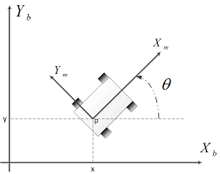
Kinematic Constraints in Mobile Robots
Degrees of Freedom (DOF):
DOF = number of independent variables to describe the robot’s pose.
A robot in the plane has 3 DOF:
• Position (x, y)
• Orientation (θ)
To move freely in 2D, all 3 must be controllable.
https://encrypted-tbn0.gstatic.com/images?q=tbn:ANd9GcQEnClMMjFnZsCj135gvLjyW9ait9HluEk2LA&s

Slide 31
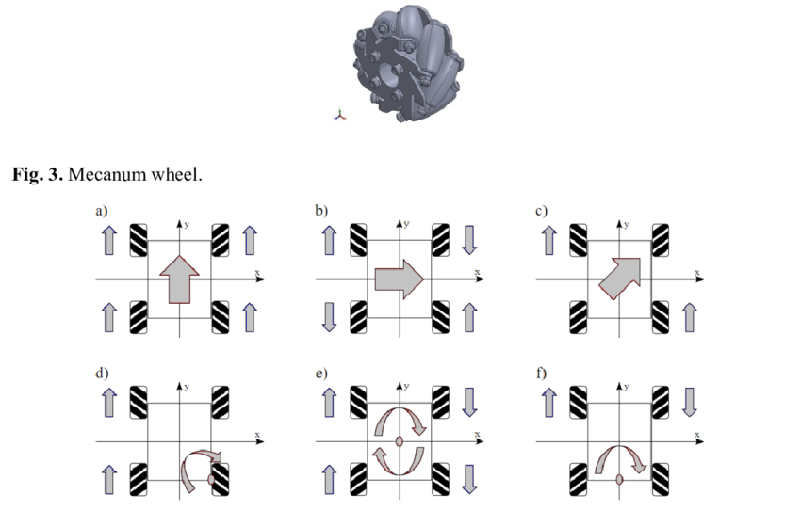
Holonomic Systems
# of independent inputs = # of DOF.
Can control x, y, and θ directly.
No velocity constraints.
Example: Omniwheel/Mecanum robots (move sideways and rotate simultaneously).
Max maneuverability, but more complex design.
https://www.researchgate.net/publication/367879750/figure/fig1/AS:11431281116841895@1675318925027/Movements-of-a-Mecanum-wheel-driven-robot-to-any-directions-side-arrows-indicate-wheel.png

Slide 32
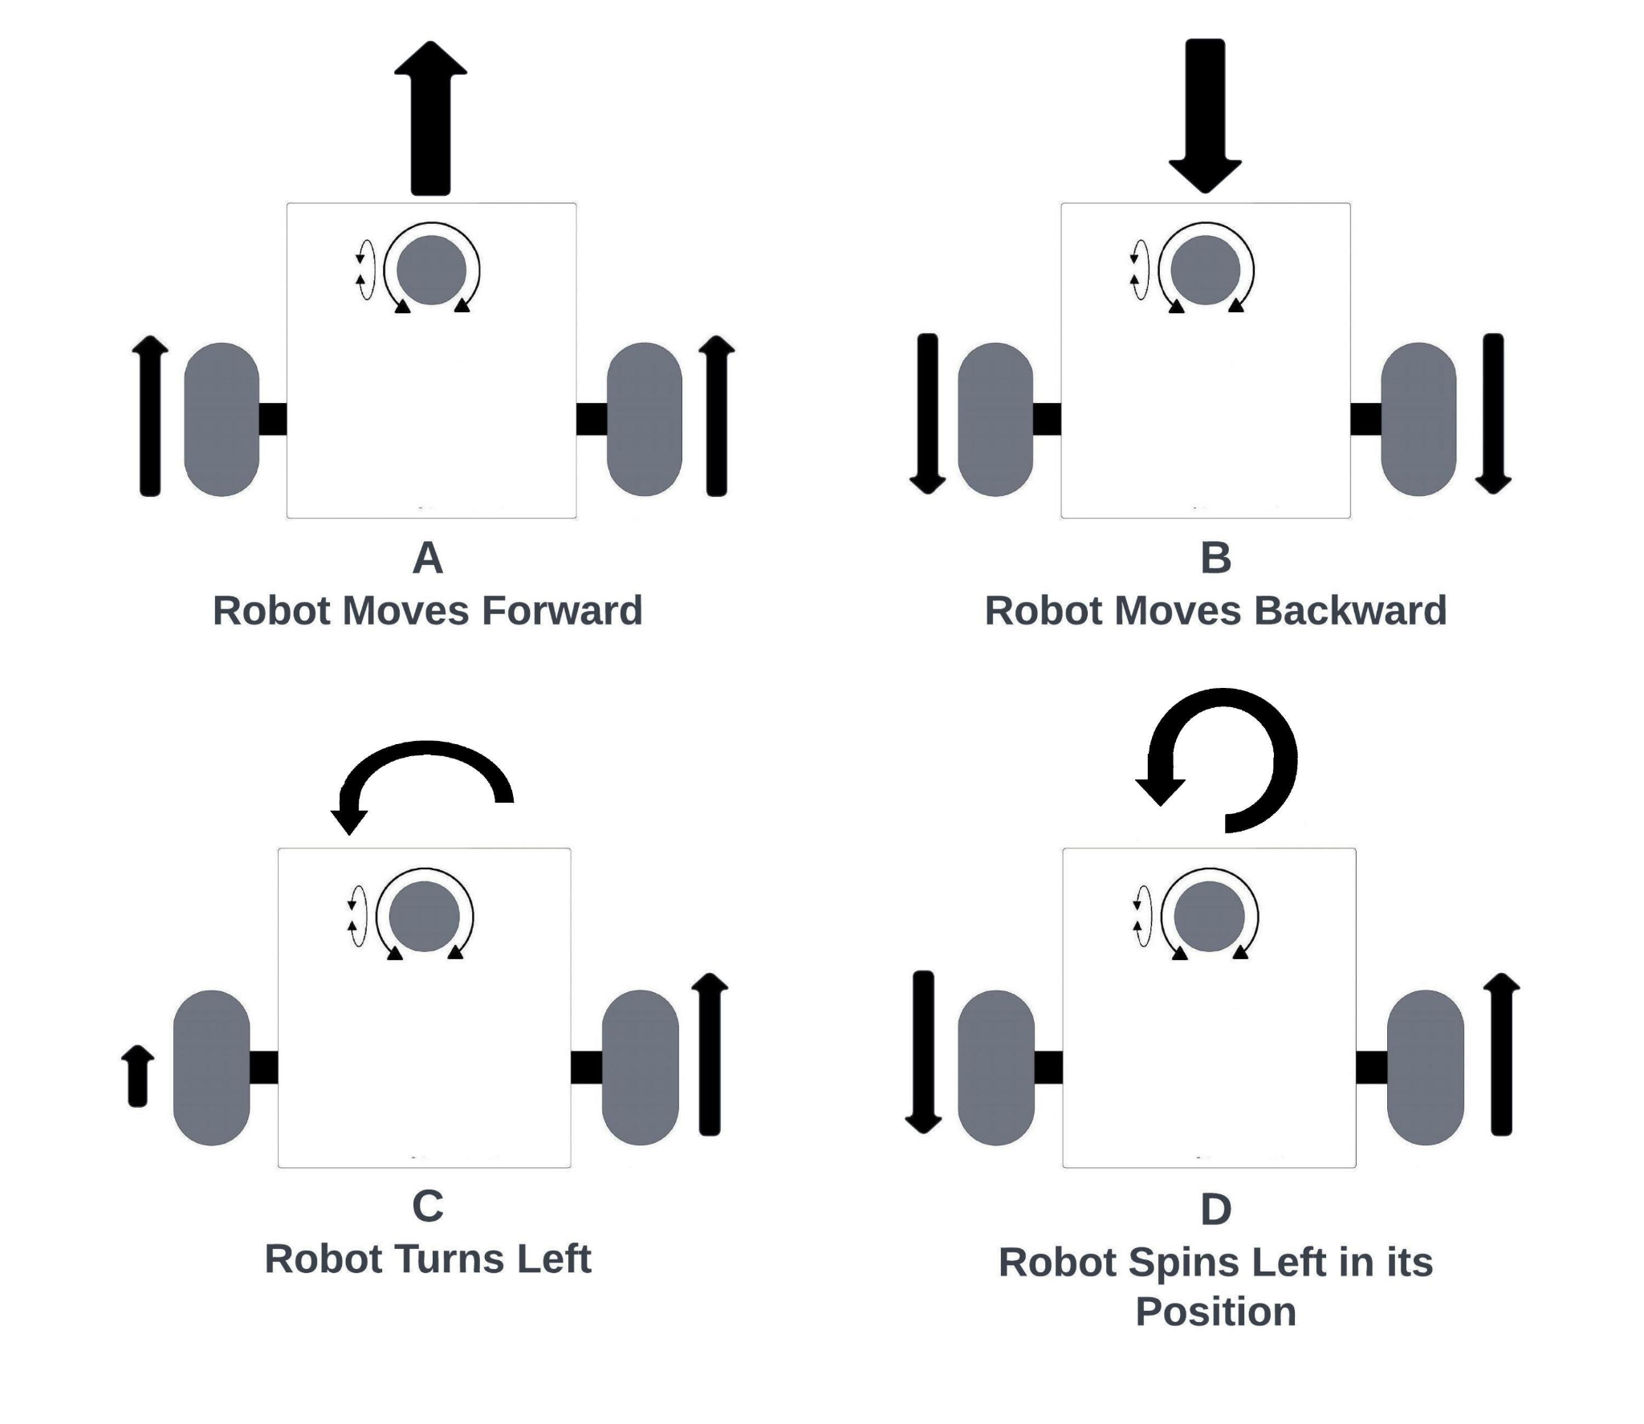
Nonholonomic Systems
Inputs < DOF → (few control inputs than 3 DOF).
Subject to velocity constraints (can’t move sideways instantly).
Must follow curved paths to change pose.
Examples: • Car / Ackermann steering • Differential-drive robots
Pros: simpler, efficient, and robust at speed.
Cons: less maneuverable, requires path planning.
https://www.theroboticsspace.com/assets/article7/Differential%202.jpeg

Slide 33
Implication - Maneuverability vs Controllability
Holonomic = max maneuverability, but mechanically complex.
Nonholonomic = simpler and efficient, but requires path planning to reach certain poses.
https://www.researchgate.net/publication/367879750/figure/fig1/AS:11431281116841895@1675318925027/Movements-of-a-Mecanum-wheel-driven-robot-to-any-directions-side-arrows-indicate-wheel.png
https://www.theroboticsspace.com/assets/article7/Differential%202.jpeg

Slide 34
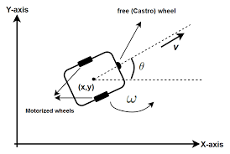
Popular Industry Design: Differential Drive
Motion Control:
Both wheels forward (equal speed) → Straight motion.
One wheel faster → Curved motion / Turning.
Wheels opposite directions → Rotation in place
Kinematic Characteristics:
2 control inputs (left & right wheel speeds).
Robot pose defined by 3 DOF (x, y, θ).
Subject to nonholonomic constraint → cannot move sideways.
https://encrypted-tbn0.gstatic.com/images?q=tbn:ANd9GcTwg4olTb2iWYJL5eaBJnTPPzceN3fAROVyZg&s

Slide 35
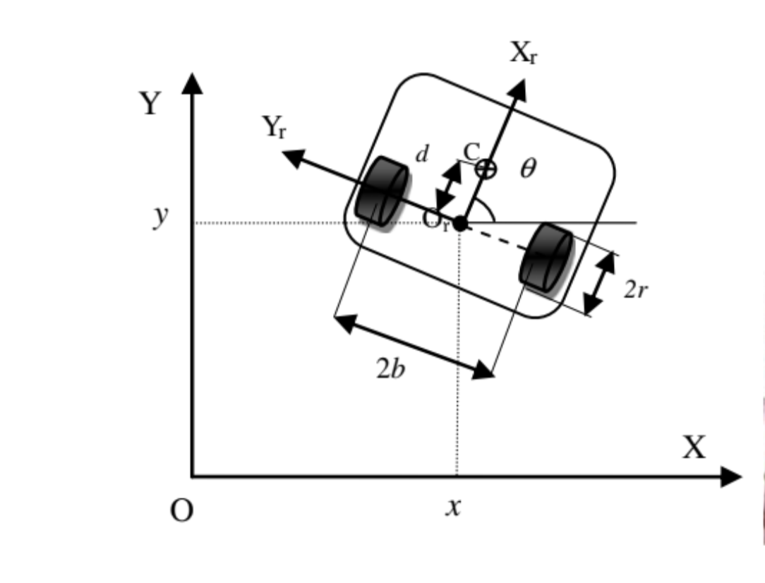
Differential Drive Robot
Among the most basic and popular drive systems for mobile robots. Two wheels on the same axis that are driven independently.
Robot pose: (x, y, θ) in the plane
Inputs: left & right wheel angular velocities: ωₗ (omega left), ωᵣ (omega right)
Linear velocity: v = (r/2) × (ωᵣ + ωₗ)
Angular Velocity:
ω = (r / 2b) × (ωᵣ − ωₗ)
Subject to nonholonomic constraint → cannot move sideways.

Slide 36
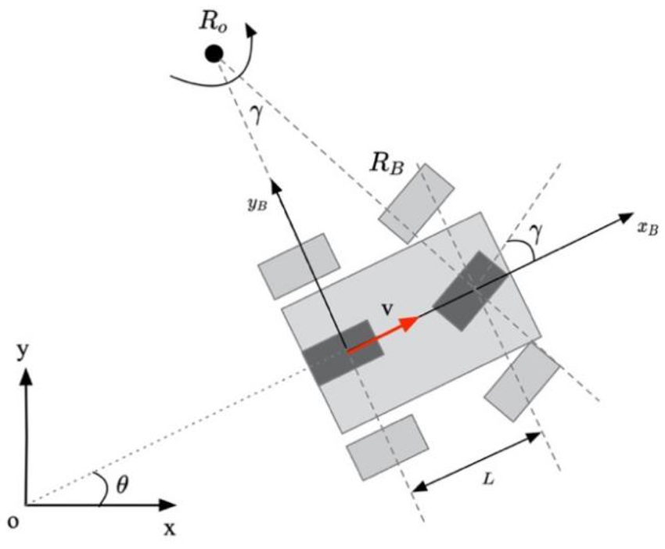
Ackerman Steering
This steering guarantees that the Instantaneous Center of Rotation (ICR) is the center of rotation for all wheels.
aligns wheel trajectories to prevent tire skidding during turns.
The inner wheel must turn more than the outer wheel.
https://www.researchgate.net/publication/365457573/figure/fig2/AS:11431281390174346@1745246558687/Kinematic-model-of-four-wheel-Ackermann-steering-structure-robot.tif

Slide 37
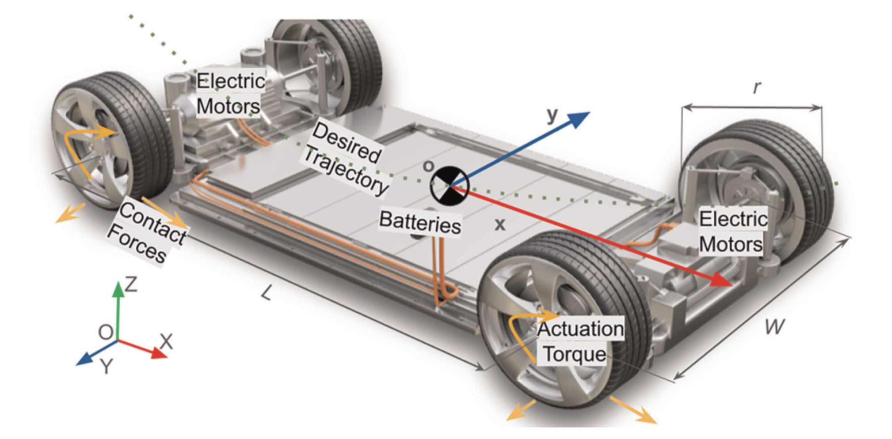
Ackerman Steering
Elements in Diagram:
δᵢ (Inner Wheel Angle): Steering angle of the inner wheel, always larger.
δₒ (Outer Wheel Angle): Steering angle of the outer wheel, smaller.
L (Wheelbase): Distance between front and rear axles.
W (Track Width): Distance between left and right wheels.
R (Turning Radius): Radius of the vehicle’s curved path, measured to the ICR.

Slide 38
Ackerman Steering
Inner and outer wheels must steer at different angles: δᵢ (inner) > δₒ (outer) From the geometry of similar triangles: cot(δᵢ) = (R − W/2) / L cot(δₒ) = (R + W/2) / L cot(δᵢ) − cot(δₒ) = W / L
https://www.researchgate.net/publication/365457573/figure/fig2/AS:11431281390174346@1745246558687/Kinematic-model-of-four-wheel-Ackermann-steering-structure-robot.tif

Slide 39
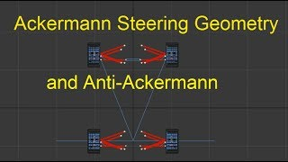
Ackerman Steering
https://www.youtube.com/watch?v=YVisLuiU-Oo

Slide 40
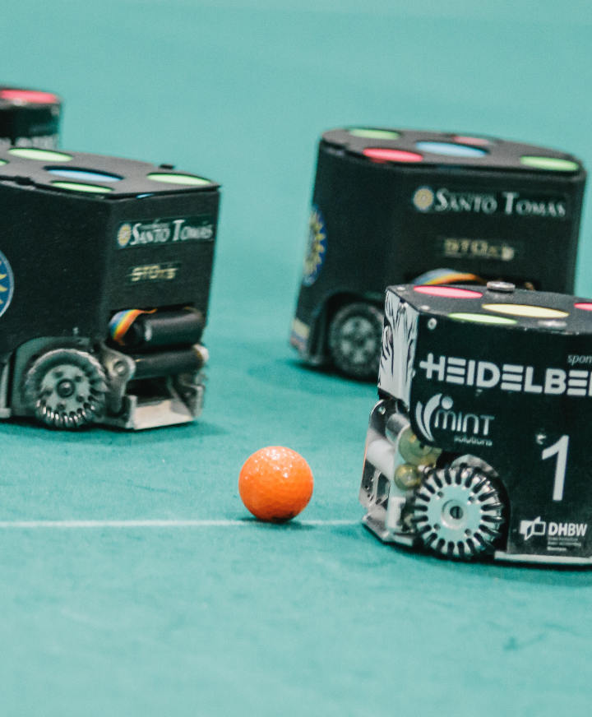
Mecanum & Omni-Wheel Robots
Can move in any direction and rotate.
Minimalist holonomic design (3 Drive Motors)
Over actuated (4 Drive Motors)
Highly Over Actuated (4 Drive Motor and 4 Steering)

Slide 41
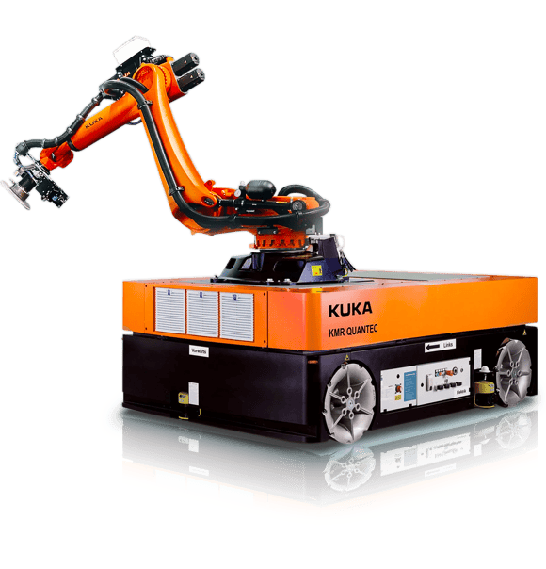
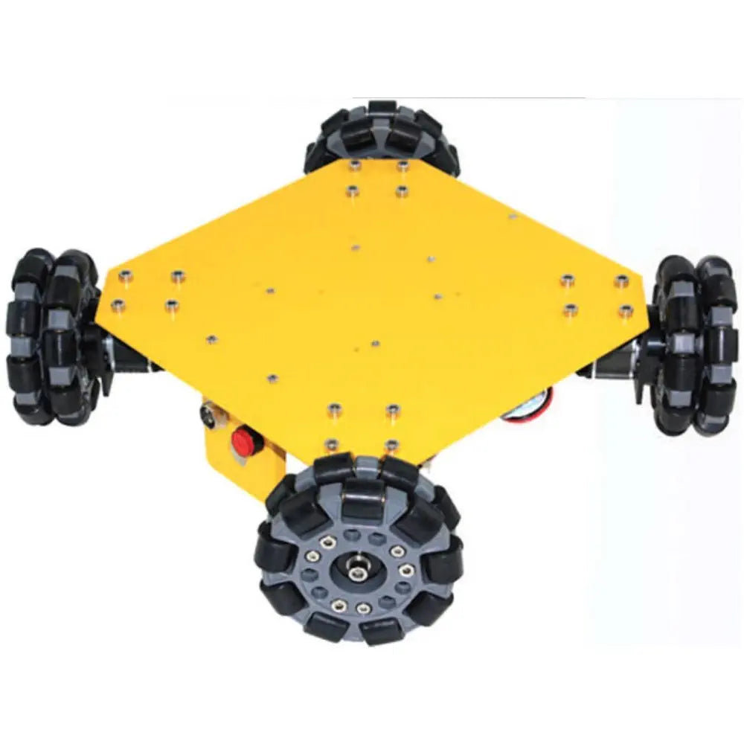
Mecanum & Omni-Wheel Robots
Can move in any direction and rotate.
Minimalist holonomic design (3 Drive Motors)
Over actuated (4 Drive Motors)
Highly Over Actuated (4 Drive Motor and 4 Steering)

Slide 42
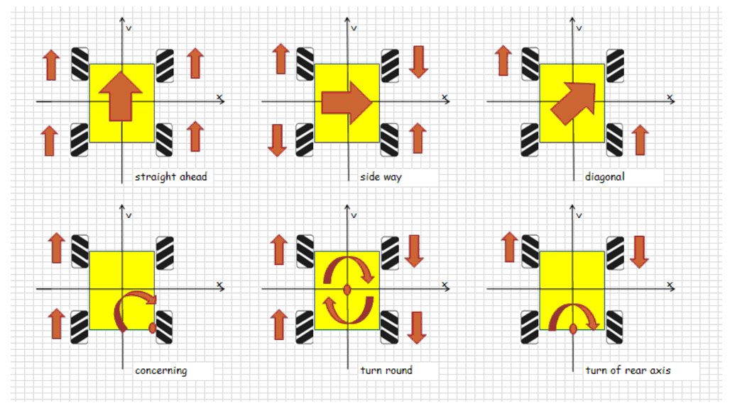
Mecanum & Omni-Wheel Robots
Mecanum wheels have rollers mounted at a 45° angle, allowing forces to be decomposed into both longitudinal and lateral components.
https://www.roboteq.com/images/article-images/frontpage/wheel-rotations.jpg

Slide 43
Mecanum & Omni-Wheel Robots
By controlling the direction and speed of each wheel independently, the robot can generate motion in any direction without changing its orientation.
https://www.roboteq.com/images/article-images/frontpage/wheel-rotations.jpg

Slide 44
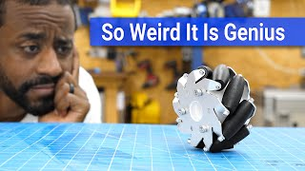
Mecanum & Omni-Wheel Robots
Full 3-DOF mobility in the plane (x, y, θ).
Supports forward/backward, sideways, diagonal, and pure rotation.
Enables smooth trajectory following for complex paths.
Eliminates the need for reorientation before lateral motion.
https://www.youtube.com/watch?v=AlsCUzCCc-k&pp=ygUp4oCcbWVjYW51bSB3aGVlbCByb2JvdCBzaWRld2F5cyBtb3Rpb27igJ0%3D

Slide 45
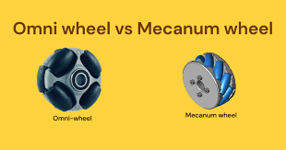
Omni vs Mecanum
Omniwheel: • Rollers at 90° → lighter, lower load capacity. • Less vibration, but more slippage.
Mecanum: • Rollers at 45° → handle heavier loads. • More vibration (roller engagement).
Both require more power than standard wheels (slip losses).
https://encrypted-tbn0.gstatic.com/images?q=tbn:ANd9GcQDJSuywNjqRGn0PviRNy8IDcaQP1XE7TcigQ&s

Slide 46
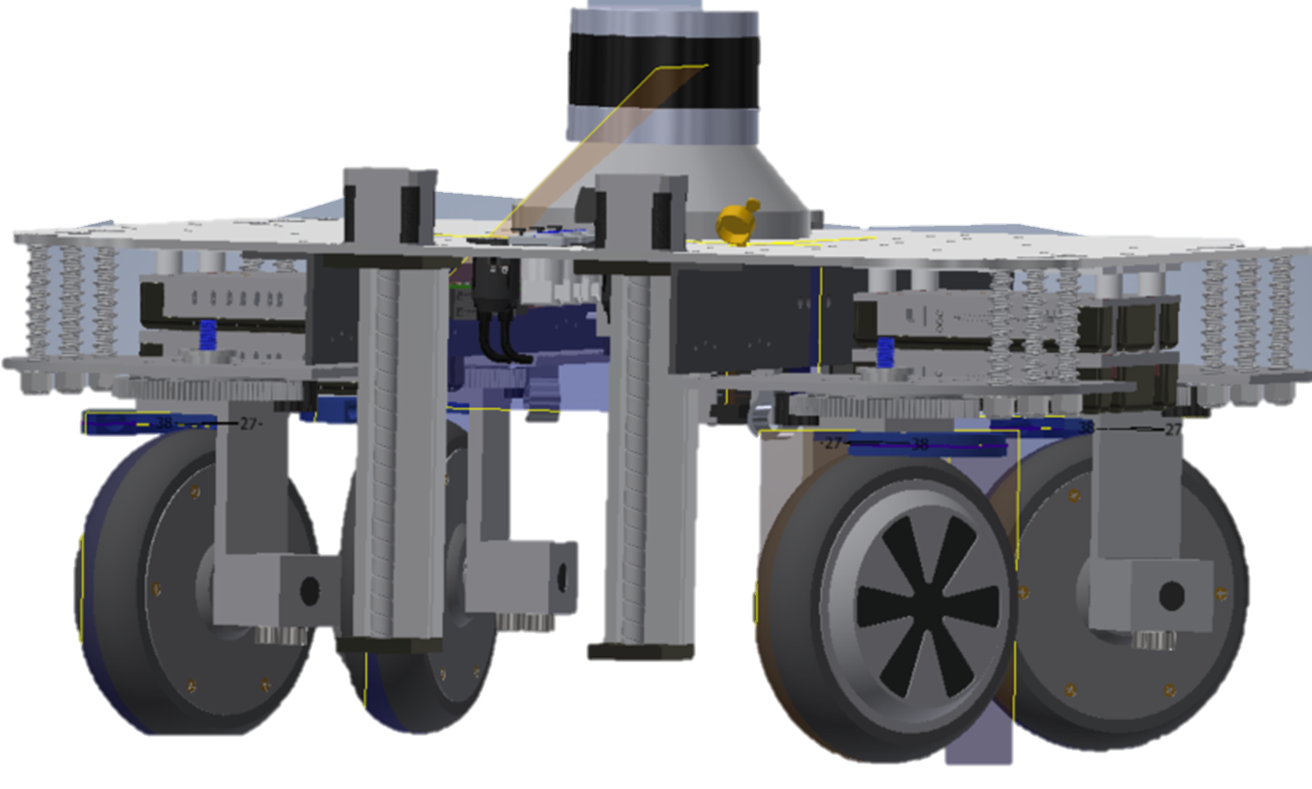
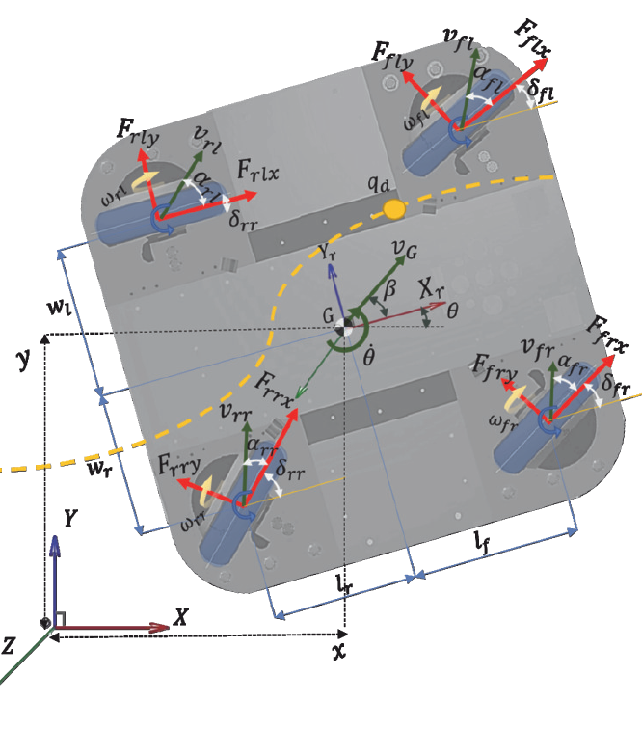
Mecanum & Omni-Wheel Robots
Can move in any direction and rotate.
Minimalist holonomic design (3 Drive Motors)
Over actuated (4 Drive Motors)
Highly Over Actuated (4 Drive Motor and 4 Steering)

Slide 47
Home Works
Choose a AMR/AV Platform
Justify why you have chosen this platform based on
Applications and Use Cases
Maneuverability
Simplicity to Design or Manufacture
Simplicity to Control

